Slide 1

Vidya Pratishthan’s Kamalnayan Bajaj Institute Of Engineering And Technology Baramati
Department of Computer Engineering

Slide 2
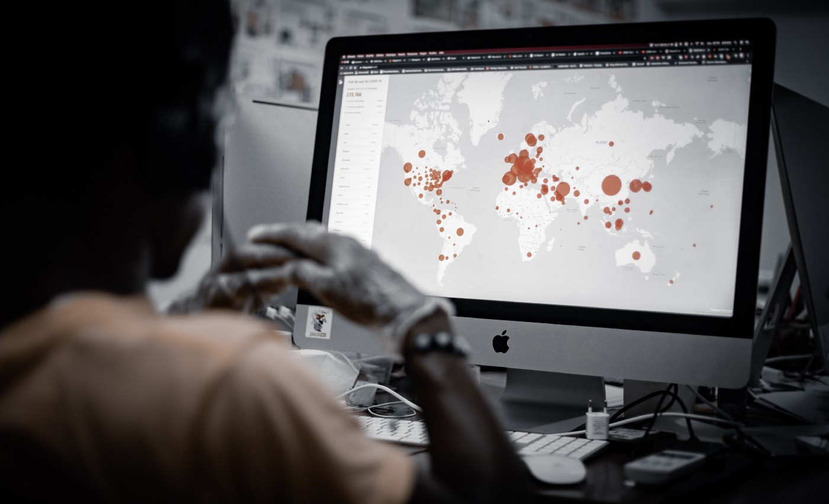
A
Mini-Project On
“Realtime Detection Of Coronavirus In The World”
Under the guidance of ,
Prof. S.N Dhage
Presented By,
Viraj J Raut
Omkar R Lokhande

Slide 3


Slide 4
Content
1. Acknowledgement
2. Introduction
3. Requirements
4. Planning
5. Implementation
6. Output
7. Applications & Future Directions
8. Conclusion
9. Reference

Slide 5
Acknowledgement
We would like to express our deep and sincere gratitude to our guide , Prof. S.N Dhage of Computer Engineering Department for his unflagging support and continuous encouragement throughout the Mini-Project work. Without his guidance and persistent help this project would have not been possible.
We must acknowledge the faculties and staffs of Computer Engineering Department of Vidya Pratishthan’s Kamalnayan Bajaj Institute Of Engineering And Technology Baramati for their support and encouragement. It’s our great pleasure to acknowledge our colleagues for providing constant co-operation , support & appreciation .

Slide 6
Introduction
Coronavirus or COVID-19 needs no introduction. It has already been declared as a pandemic by WHO and in past couple of weeks it’s impact has been deleterious from both health perspective and an economic one . As of now, most of us are staying and working from home to avoid the spread of corona virus. We decided to utilize the surplus time to write a Python Script that pulls the latest country wise data of COVID-19 cases from the official website of Ministry of Health and Family Welfare, Government of India and turn it into insightful visualizations using popular Python packages like Matplotlib, Tkinter, Covid & Plyer. We can not avoid the curiosity about knowing what is happening in the world , people now days spend most of their time in searching for the number of cases about new patients or deaths in their state or country . This project will not only help them by providing real-time updates but also while saving their time.

Slide 7
Requirements
Dataset :
In these project we use various modules & packages for designing the projects , Using these modules and packages we can directly import dataset into data frames . It is much better to use the URLs than to download the file manually and then read it as it becomes easier to load and refresh the analysis with new data .
System Requirements :
1. Visual Studio
2. Any Operating System like Windows , Linux , etc
3. 4 GB RAM minimum, 8 GB RAM recommended
4. 2 GB of available disk space minimum
5. 1280 x 800 minimum screen resolution

Slide 8
Planning
For every project the planning is most important , we would have made the project with the help of following Modules , Packages and GUI system .
1)Matplotlib - One of the greatest benefits of visualization is that it allows us visual access to huge amounts of data in easily digestible visuals like graph , charts .
2) tkinter - It is a graphical user interface (GUI) module for Python, you can make desktop apps with Python. You can make windows, buttons, show text and images amongst other things
3) Covid package – We use random dataset on Covid 19 for read the data .
4) Plyer package – These package is used for desktop notifier application .

Slide 9
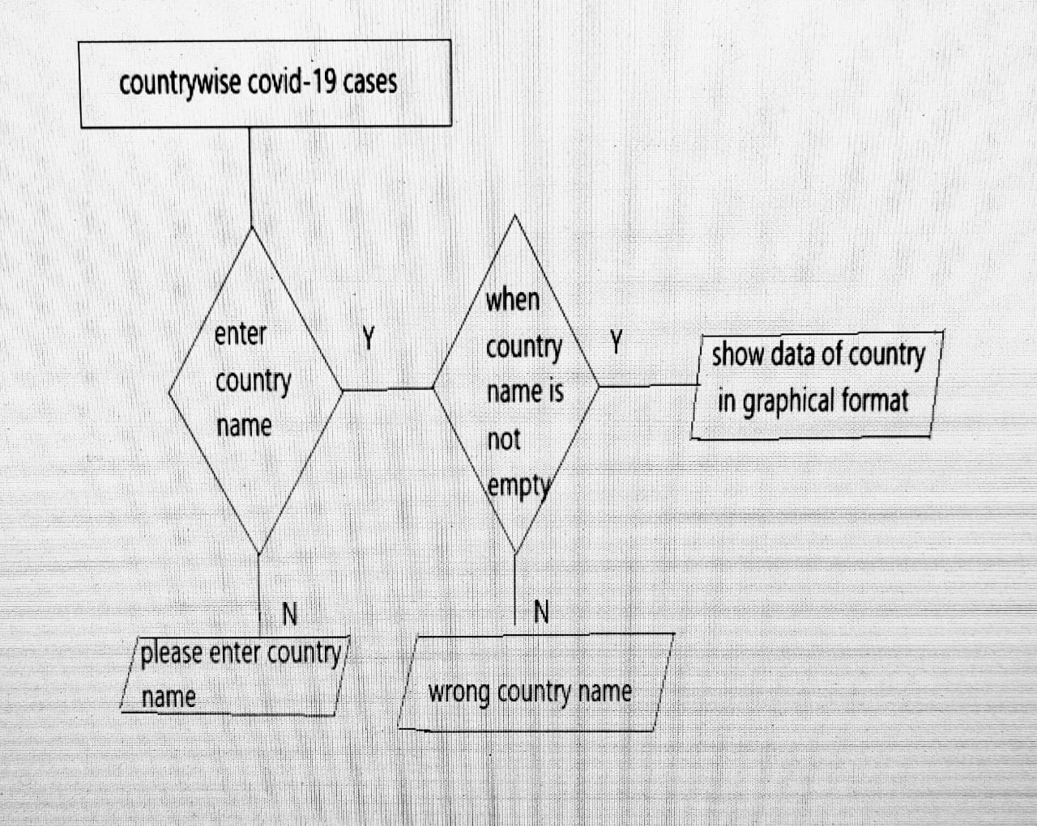
Following is Flowchat of our project First user will enter the country name then if this country name is valid then it shows count of death cases , recovered cases ,active cases of covid patients , otherwise if country name is not valid then it gives message like enter valid country name .
Flowchart :

Slide 10
Implementation
As we know the whole world is being affected by the COVID-19 pandemic and almost everyone is working from home. We all should utilize this duration at best, to improve our technical skills or writing some good Pythonic scripts. Let's see a simple Python script to demonstrate the Country-wise coronavirus cases in Era . This Python script fetches the live data from the Ministry of Health Affairs Official Website. Then data is represented in the Pie charts .
To run this script follow the below ,
Step 1 Importing Libraries
from tkinter import *
import tkinter.messagebox as t
from covid import Covid
import matplotlib.pyplot as p covid=Covid()

Slide 11
Step 2. Extract Contents from Covid Package and Pie Chart
root=Tk()
root.geometry("800x500")
root.title("covid-19->Project by :Omkar Lokhande and Viraj Raut ")
def notifyme(title,message):
notification.notify( message=message, timeout=50)
def showdata():
a = abc.get()
if (a == ""):
t.showinfo("info", "Please enter country name")
else:
try:
a = a.lower()
getdata = covid.get_status_by_country_name(a)
a = a.title()
p.title(f"Covid-19: Cases in {a}")
keys = ["confirmed cases", "recovered", "active cases", "death"]
values = [getdata["confirmed"], getdata["recovered"], getdata["active"], getdata["deaths"]]
p.axis("equal")
p.pie(values, labels=keys, radius=1, shadow=True, startangle=180, autopct="%0.0f%%")
p.legend()
p.text(1.727, -0.212, f"*Confirmed Cases:{values[0]}\n\n" f"*Recovered Cases:{values[1]}\n\n" f"*Active:{values[2]}\n\n" f"*Death:{values[3]”)

Slide 12
# to add text on matplotlib
notifyme("GOVIND", "Stay Home Stay Safe !")
notifyme("GOVIND", "Keep Social Distance!")
notifyme("GOVIND", "Always Wear Mask !")
notifyme("GOVIND","Sanitize Your Hands !")
p.show()
except:
t.showinfo("info", "Wrong Country Name")
label=Label(root,text="Covid-19:Country Wise Cases",bg="red",font=("comicsansns",25,"bold"))
label.pack()
label=Label(root,text="\nEnter Country Name:",font=("comicsansns",15,"bold")) label.pack()
abc=StringVar()
screen=Entry(root,textvariable=abc,font="lucida 15 bold")
screen.pack(padx=10,pady=10) print("\n") m=Button(root,bg="yellow",text="Show",padx=20,pady=5,font=("comicsansns",10," bold"),command=showdata)
m.pack()
root.mainloop()

Slide 13
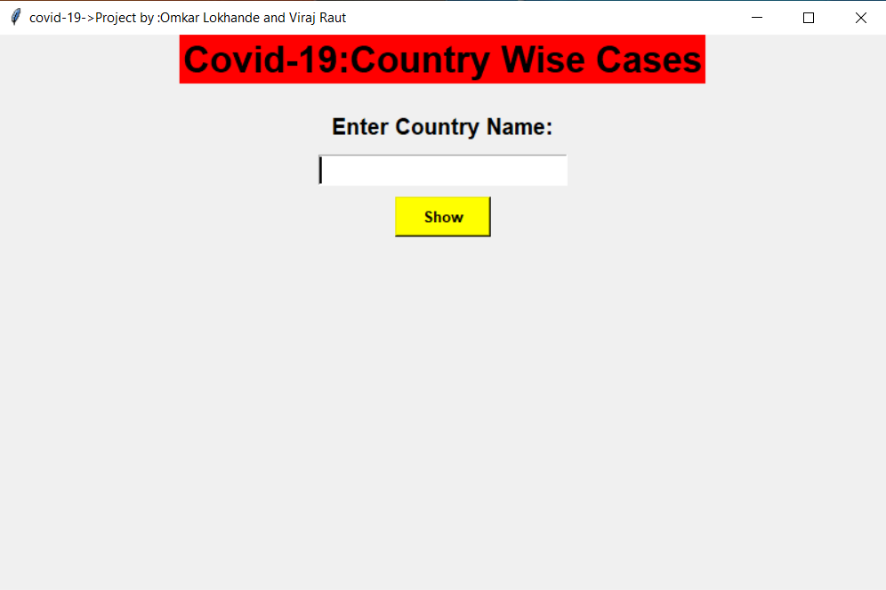
Output

Slide 14
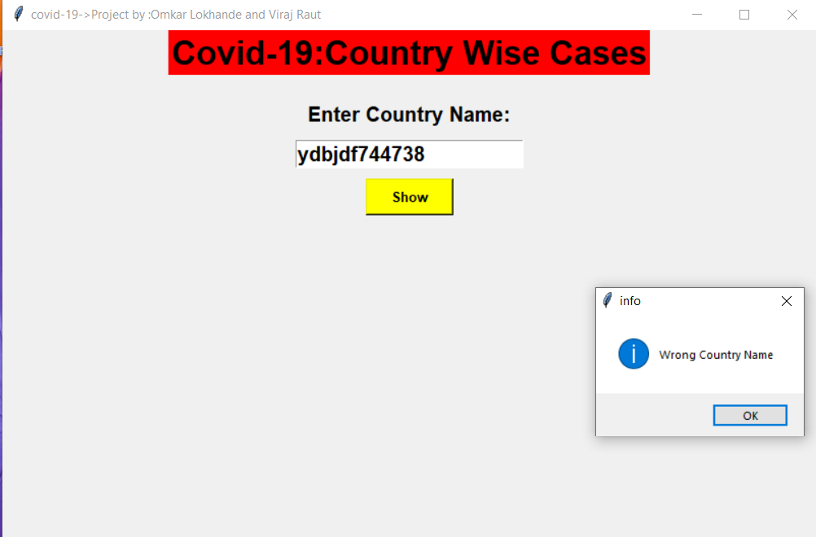

Slide 15
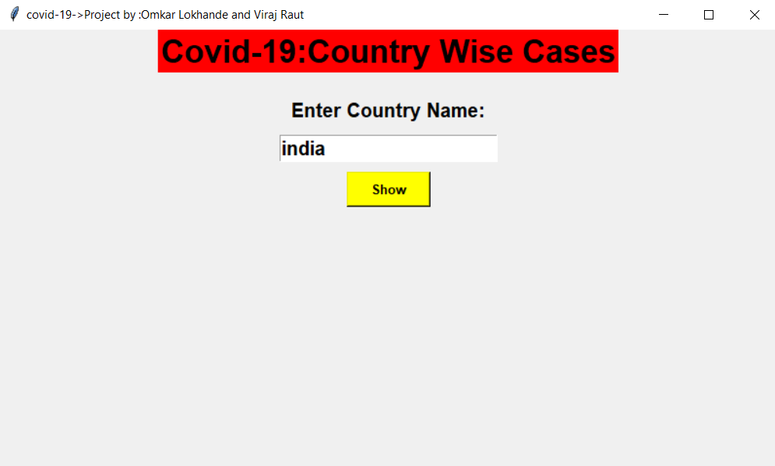

Slide 16
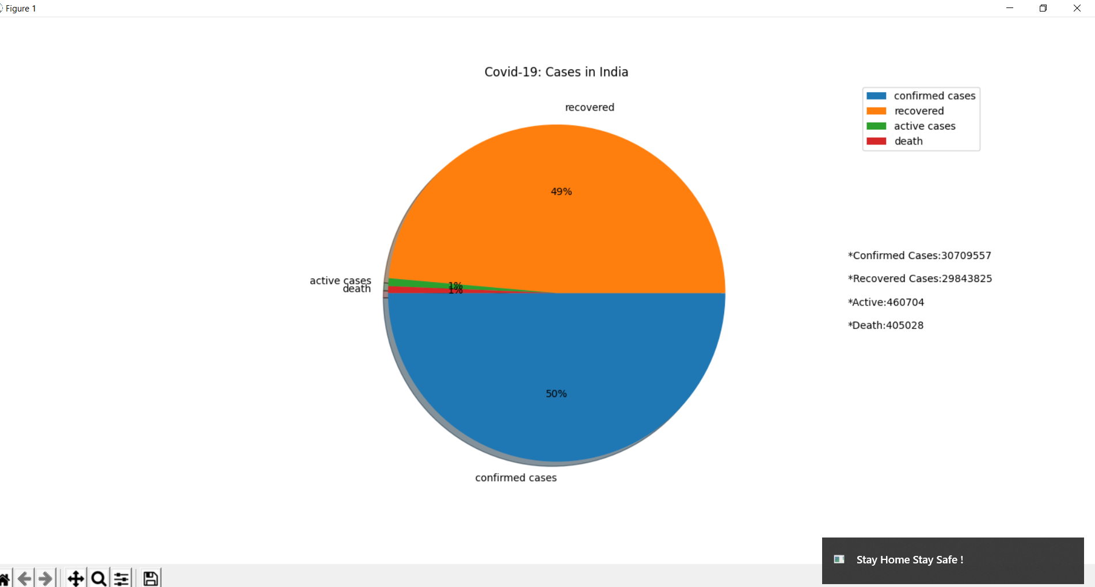

Slide 17
Applications
The spread of the global pandemic, COVID-19, has generated a huge and varied amount of data, which is increasing rapidly. This data can be used by applying big data analytics techniques in multiple areas, including diagnosis, estimate or predict risk score, healthcare decision-making, and pharmaceutical industry and potential application areas.
This data help us as ,
1.Detect and Track Symptoms of Covid-19 .
2.Healthcare Decision making & Determine patient Priority .
3.Define infection places , epidemic spread estimate & contact tracing .
4.Determine the care needed , medical resource needs & quarantine need .
5.Determine the psychological impact of the covid -19 outbreak .
6.This data help to improve risk management and improve marketing insight .

Slide 18
Future Directions
Most countries have made many efforts to contain the spread of COVID-19 and mitigate its repercussions, as they have faced various challenges, including the cost and limited capacity for the COVID-19 test. There is a lack of immediate data to proactively manage resources, such as the distribution of medical staff between regions, as well as the estimated ventilators required for each hospital, which depends on the expected numbers of patients and their different needs. Therefore, we recommend this data analytics tools to assist stake holders to make decisions and predict the future .
This data can be used at MoH Level : Real-time data visualization for the number of active and infected cases can help the MoH to identify the areas that contain huge numbers of COVID-19 patients. it can aid the health professionals and decision makers to provide more health facilities in the areas with huge numbers of COVID-19 patients.
This data can be used at Patients Level : Real-time analysis of hospital data that are related to admitted patients, waiting lists, and hospital capacity helps individuals locate less crowded hospitals with earlier appointments and less waiting time

Slide 19
It can be used at Responsible Authorities level : Analyzing mobile data helps in identifying polluted public places for disinfection andquarantining infected people and their contacts, even if they do not show any symptoms .
It can be used at Hospital Level : The analysis of remote patient monitoring data can assist in estimating the number of patients in a specific area to optimally plan for containing any expected increase in the number of patients beyond the hospital capacity.
So this are some highlighted future directions that should be considered in to make decisions and protect the future .

Slide 20
Conclusion
The volume of data increases dramatically over time, especially data generated on the global pandemic caused by COVID-19. Such volume of data requires utilizing big data analytics tools along with AI techniques to make sense of the pandemic and control its spread in a timely manner.
In these way we can analysis the dataset using python and can estimate other the factors like Graphical Representation and Notifications of COVID - 19 norms as well . I hope that now it would be easy for you to create , analysis and monitor the consequences and effects of Covid-19 .

Slide 21
Reference
1. https://www.analyticsvidhya.com/blog/2021/02/key-python-packages-for-data-science/
2. Lee, I.-K.; Wang, C.-C.; Lin, M.-C.; Kung, C.-T.; Lan, K.-C.; Lee, C.-T. Effective Strategies to Prevent Coronavirus Disease-2019 (COVID-19) Outbreak in Hospital. J. Hosp. Infect. 2020, 105, 102–103. [CrossRef] [PubMed]
3. Iacobucci, G. Covid-19: Emergency Departments Lack Proper Isolation Facilities, Senior Medic Warns. BMJ 2020, 368, m953.[CrossRef] [PubMed]
4. Worldometers Coronavirus Cases. Available online: . https://www.mohfw.gov.in/
5. Da’Ar, O.B.; Haji, M.; Jradi, H. Coronavirus Disease 2019 (COVID -19): Potential Implications for Weak Health Systems and Conflict Zones in the Middle East and North Africa region. Int. J. Health Plan. Manag. 2020, 35, 1240–1245. [CrossRef]

Slide 22
Thank You …!
Covid-19 hasn’t yet hit India in a widespread way. The missing pieces of data are making it impossible to predict how the outbreak will unfold in the coming months. I pray for the safety and well-being of everyone in India and around the world.

